Slide 1
House Price Regression Model
By David Chrobak

Slide 2
Objective
My job was to build a model that will predict the price of a house based on features provided in the dataset. Senior management also wants to explore the characteristics of the houses using some business intelligence tools. One of those parameters includes understanding which factors are responsible for higher property value - $650K and above.

Slide 3
Location location location !!!
Many members of Family of my family are among the several individuals whom have taken their talents to ‘South Beach’ if you will.
and no, Im not talking about the NBA.
I am refering to Real Estate
I long been given the speech that ‘Location is key”
There is no difference in this data here.
Please allow me Allow me to explain

Slide 4
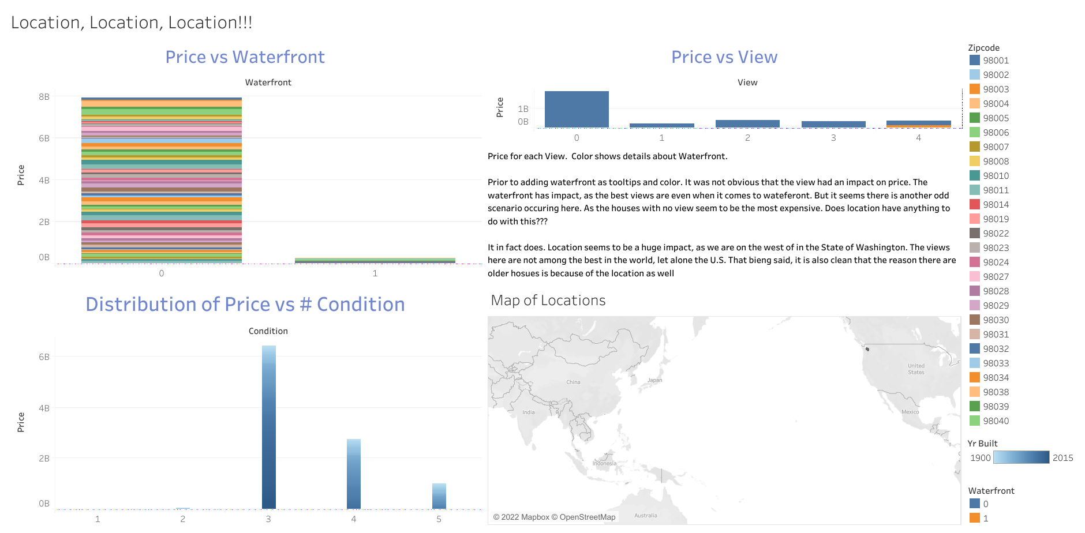

Slide 5
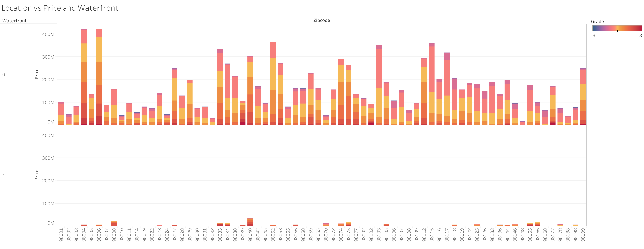
Here I was trying to see how grade played into the location variables
- I found that the grades were evenly distributed. With both highs and lows across the data set.
- Waterfront had almost zero effect on the grade.

Slide 6
https://public.tableau.com/app/profile/david.chrobak.jr/viz/ProjectExample_16551179748470/SumofPricevsZipcode?publish=yes

Slide 7
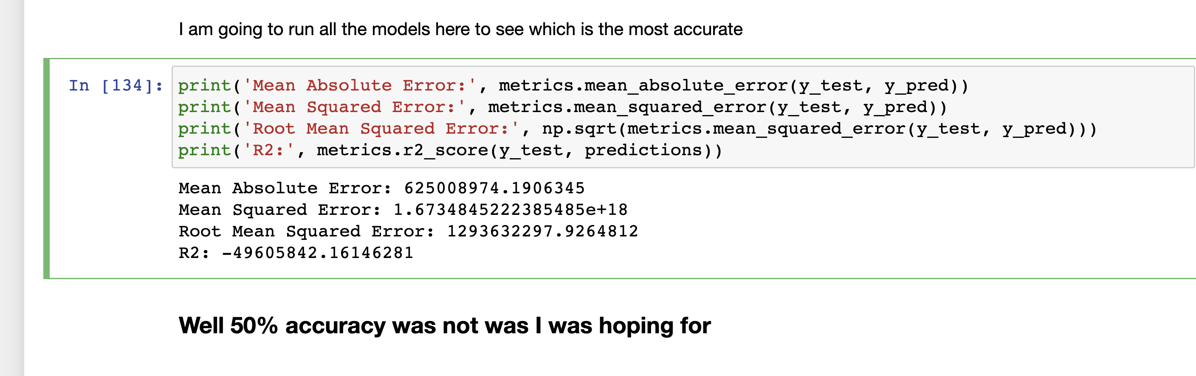
Conclusion
My Model was not the most accurate, and location did play a huge factor. However, view and waterfront did not have the impact I was anticipating.

